Slide 1
XML & SSML Introduction
Jackie Cao
John WU
April 25, 2007

Slide 2
Declaration
This PPT is a tailored introduction, which only contains the information necessary for the project.
For further information, browsing the websites mentioned in the "Reference" section is strongly recommended.

Slide 3
Agenda
XML Introduction
SSML
XML DOM

Slide 4
What is XML ?
XML
  stands for Extensible Markup Language
  was designed to describe data
  tags are not predefined
  self-descriptive
  W3C Recommendation
XML is a cross-platform, software and hardware independent tool for transmitting information.

Slide 5
XML vs. HTML
XML and HTML were designed with different goals:
  XML was designed to describe data and to focus on what data is.
  HTML was designed to display data and to focus on how data looks.
XML
  is a complement to HTML
  is not a replacement for HTML

Slide 6
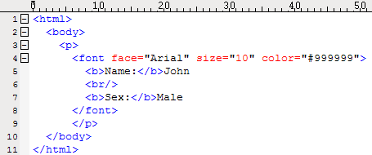
Example of HTML

Slide 7
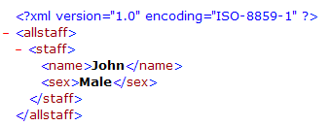
Example of XML

Slide 8
XML document structure
Prolog:
  <?xml version="1.0" encoding="ISO-8859-1"?>
Document Type Declaration (DTD):
  External Declaration:
    <!DOCTYPE root-element SYSTEM "filename">
  Internal Declaration:
    <!DOCTYPE root-element [element-declarations]>
XML Schema
  An XML based alternative to DTD

Slide 9

XML document structure (cont.)
Root node, child node & attributes

Slide 10
Well Formed XML
XML with correct syntax is Well Formed XML.
  XML documents must have a root element
  XML elements must have a closing tag
  XML tags are case sensitive
  XML elements must be properly nested
  XML attribute values must always be quoted

Slide 11
Valid XML
A "Valid" XML document also conforms to a DTD.
  A DTD defines the legal elements of an XML document.
  A DTD defines "content model" which includes child elements, counts and sequences.

Slide 12
Agenda
XML Introduction
SSML
XML DOM

Slide 13
SSML
SSML: Speech Synthesis Markup Language

Slide 14
Speech Synthesis Process Steps
Speech Synthesis Process Steps
  XML parse (xml, prep)
  Structure analysis (struct)
  Text normalization (lang, norm)
  Text-to-phoneme conversion (word, pos, gtp)
  Prosody analysis (psg, prosgen)
  Waveform production (unitsel, prosmod, synth, wavfmt)

Slide 15
Document Structure, Text Processing and Pronunciation
Prolog
  <?xml version="1.0" encoding="…" ?>
DOCTYPE
  <!DOCTYPE speak PUBLIC "-//W3C//DTD SYNTHESIS 1.0//EN"
  "http://www.w3.org/TR/speech-synthesis/synthesis.dtd">
speak Root Element
  <speak>
  Required Attributes: xml:lang / version
  Optional Attribute: xml:base
  Valid Child Elements: audio, break, emphasis, lexicon, mark, meta, metadata, p, phoneme, prosody, say-as, sub, s, voice, w

Slide 16
Document Structure, Text Processing and Pronunciation
Language: xml:lang * Attribute
  xml:lang is a defined attribute for the speak, p, s and w elements.
Text Structure: p, s and w Elements
  A p element represents a paragraph.
  An s element represents a sentence.
  A w element represents a word.
  Valid Child Elements: audio, break, emphasis, mark, phoneme, prosody, say-as, sub, s (for p), w (for p and s), voice.
say-as Element
  Required Attribute: interpret-as
  Optional Attributes: format / detail
  Example
    <say-as interpret-as=’date’ format=’y’>1992</say-as>
* More information & changes in the new SSML standard will be discussed later

Slide 17
Document Structure, Text Processing and Pronunciation
phoneme Element
  The phoneme element may be empty
  The phoneme element itself can only contain text (no elements).
  The phonemic/phonetic string does not undergo text normalization and is not treated as a token for lookup in the lexicon, while values in say-as and sub may undergo both.
  Required Attribute: ph
  Optional Attribute: alphabet
  Example:
    <phoneme alphabet="ipa" ph="t&#x259;mei&#x325;&#x27E;ou&#x325;">tomato </phoneme>
    <-- use the UTF-8 representation of these symbols: "təmei̥ɾou̥". -->

Slide 18
Prosody and Style
voice Element
  The voice element is a production element that requests a change in speaking voice.
  Required Attribute: at least one optional attribute
  Optional Attributes: xml:lang (languages)*, gender, age, variant, name
  voice attributes are inherited down the tree including to within elements that change the language.
  Example:
    <voice gender="female">
      Any female voice here.
      <voice age="6">
        A female child voice here.
        <p xml:lang="ja">
        <!-- A female child voice in Japanese. -->
        </p>
      </voice>
    </voice>

Slide 19
Prosody and Style
emphasis Element
  Optional Attribute: level
    level: the optional level attribute indicates the strength of emphasis to be applied. Defined values are "strong", "moderate", "none" and "reduced". The default level is "moderate".
    Attention to reduce:
      For example, when the phrase "going to" is reduced it may be spoken as "gonna".
break Element
  Optional Attributes: strength / time
    strength: "none", "x-weak", "weak", "medium" (default value), "strong", or "x-strong".
    time: e.g. "250ms", "3s".

Slide 20
Prosody and Style
prosody Element
  The prosody element permits control of the pitch, speaking rate and volume of the speech output.
  Required Attribute: at least one optional attribute
  Optional Attributes:
    pitch
      a number followed by "Hz"
      a relative change
      "x-low", "low", "medium", "high", "xhigh", or "default"
    Contour
    Range
      a number followed by "Hz"
      "x-low", "low", "medium", "high", "xhigh", or "default"
    Rate
      a relative change
      "x-slow", "slow", "medium", "fast", "x-fast", or "default".
    Duration
    Volume
      Number (0.0~100.0)
      a relative change
      "silent", "x-soft", "soft", "medium", "loud", "x-loud", or "default".

Slide 21
Other elements
See http://www.w3.org/TR/speech-synthesis/ for details.

Slide 22
XML:lang in new SSML standard
The language attribute "xml:lang" is no longer used in voice element, now it's "languages"
  For we are not using voice at the moment, detailed information about languages attribute will be discussed later.
In other elements, such as <speak>, <p>, <s>, <w>, "xml:lang" represents more:
  The format of xml:lang
    Language-Target Synthesis Language-Text Script Language ?
  Valid usages:
    A-B
      zh-cmn: Chinese-use Mandarin as synthesis language
      zh-yue: Chinese-Cantonese
    A-C
      zh-Hans: Chinese-text is scripted in Simplified Chinese
      zh-Hant: Chinese-Traditional
    A-B-C
      zh-yue-Hans: Use Cantonese as synthesis language, but the text is written in Simplified Chinese

Slide 23
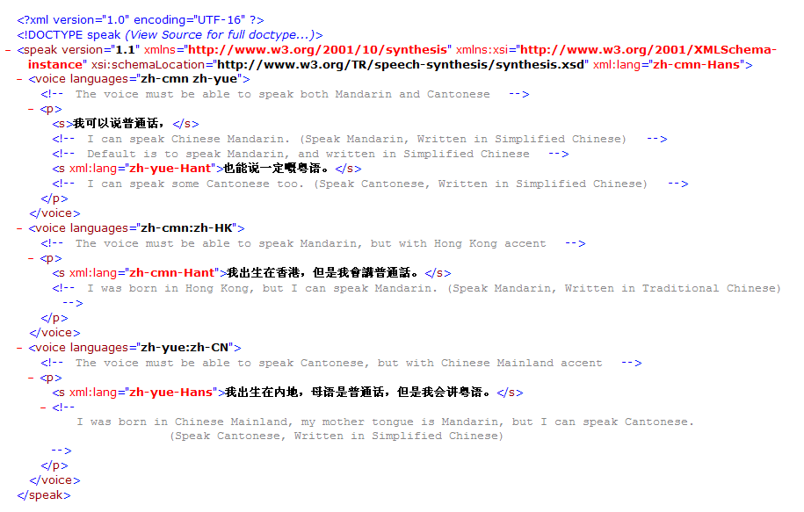

Slide 24
Agenda
XML Introduction
SSML
XML DOM

Slide 25
XML DOM
DOM: Document Object Model
  The XML Document Object Model (XML DOM) defines a standard way for accessing and manipulating XML documents.
  The DOM presents an XML document as a tree-structure (a node tree), with the elements, attributes, and text defined as nodes.

Slide 26
XML DOM Tree
Example from "Module Division and SSML Specification" by John.

Slide 27
Reference
XML
  http://www.w3.org/XML/
  http://www.w3schools.com/xml/default.asp
DOM
  http://www.w3.org/DOM/
  http://www.w3schools.com/dom/default.asp
SSML
  http://www.w3.org/TR/speech-synthesis/

